Slide 1
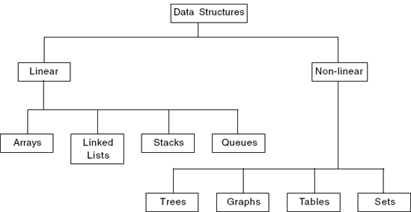
Classification

Slide 2
Stacks
Allow insertions and removals only at top of stack
Queues
Allow insertions at the back and removals from the front
Linked lists
Allow insertions and removals anywhere
Binary trees
High-speed searching and sorting of data and efficient elimination of duplicate data items

Slide 3
Stacks

Slide 4
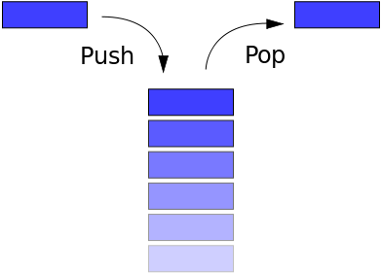
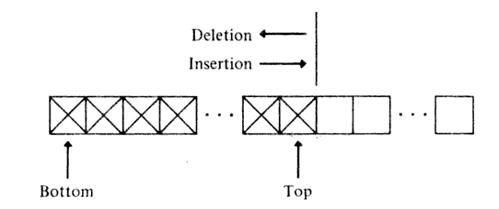
Introduction
Stack is an important data structure which stores its elements in an ordered manner.
A stack is a linear data structure which uses the principle, i.e., the elements in a stack are added and removed only from one end, which is called the top.
Hence, a stack is called a LIFO (Last-In, First-Out) data structure as the element that is inserted last is the first one to be taken out.

Slide 5

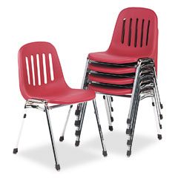
Introduction
Real life examples of stack:
Suppose we have created stack of the book
How books are arranged in the stack?
Books are kept one above the other
Books which are inserted first is taken out last. (brown)
Book which is inserted lastly is served first. (light green)
Suppose at your home you have multiple chairs then you put them together to form a vertical pile. From that vertical pile, the chair which is placed last is always removed first.
Chair which was placed first will be removed
last.

Slide 6
Array representation of stacks
In computer’s memory stacks can be represented as a linear array.
Every stack has a variable TOP associated with it.
TOP is used to store the address of the topmost element of the stack. It is this position from where the element will be added or deleted.
There is another variable MAX which will be used to store the maximum number of elements that the stack can hold.
If TOP = NULL, then it indicates that the stack is empty and if TOP = MAX -1, then the stack is full.

Slide 7
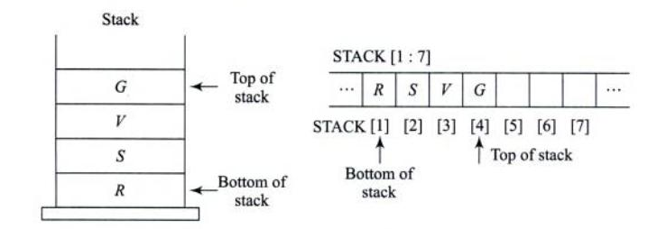
Array representation of stacks

Slide 8
Operations of Stack
Push : inserting element onto stack.
Pop : removing element from stack.
Peep : returns the i^{th} element from top element of the stack.
Change : changes the i^{th} element from top of stack to the mentioned element.

Slide 9
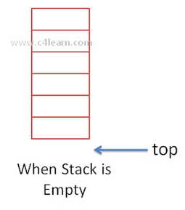
Visual Representation of Stack
View 1: When stack is empty
When stack is empty then it does not contain any element inside it. Whenever stack is empty, the position of topmost element is -1.

Slide 10
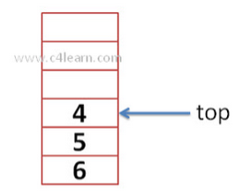
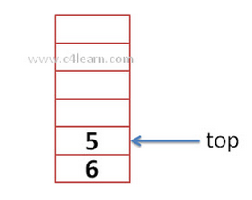
Visual Representation of Stack
View 2: When stack is not empty
Whenever we add very first element then topmost position will be increment by 1. After adding first element, top = 0.
View 3: After deletion of 1 element top will be decremented by 1.

Slide 11
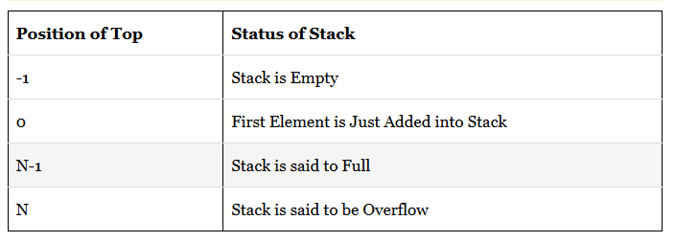
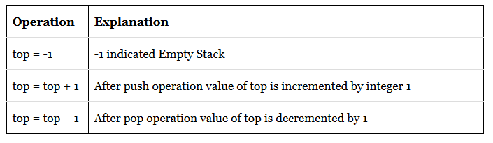
Visual Representation of Stack
Position of top and its value:
Values of stack and top:

Slide 12
Push Operation
Procedure PUSH(S, TOP, X): This procedure inserts an element X on the top of a stack which is represented by a vector S containing N elements with a pointer TOP denoting the top element in the stack.
Algorithm to PUSH an element in a stack
Step 1: IF TOP = N-1, then
PRINT “OVERFLOW”
Goto Step 4
[END OF IF]
Step 2: SET TOP = TOP + 1
Step 3: SET S[TOP] = X
Step 4: END

Slide 13
Pop Operation
Procedure POP(S, TOP): This procedure removes the element from the stack which is represented by a vector S and returns the element.
Algorithm to POP an element from a stack
Step 1: IF TOP = -1, then
PRINT “UNDERFLOW”
Goto Step 4
[END OF IF]
Step 2: SET TOP = TOP - 1
Step 3: Return S(TOP+1)
Step 4: END

Slide 14
Peek Operation
Procedure PEEP(S, TOP, I): Given the vector S (consisting of N elements) representing a sequentially allocated stack, and a variable TOP denoting the top element of the stack, this function returns the value of the i^{th} element from the top of the stack. The element is not deleted by this function.
Algorithm to PEEP an element from a stack
Step 1: IF TOP – I < 0, then
PRINT “UNDERFLOW”
Goto Step 3
[END OF IF]
Step 2: Return S(TOP – I)
Step 3: END

Slide 15
Change Operation
Procedure CHANGE(S, TOP, X, I): Given the vector S (consisting of N elements) representing a sequentially allocated stack, and a pointer TOP denoting the top element of the stack, this procedure changes the value of the i^{th} element from the top of the stack to the value contained in X.
Algorithm to CHANGE an element from a stack
Step 1: IF TOP – I < 0, then
PRINT “UNDERFLOW”
Goto Step 3
[END OF IF]
Step 2: S(TOP – I) = X
Step 3: END

Slide 16
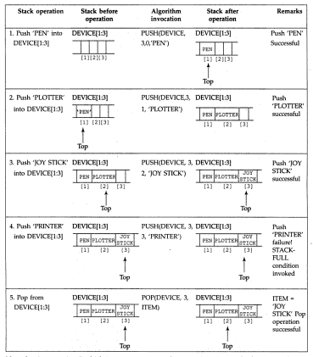

Slide 17
Applications of Stack
Expression conversion
Expression evaluation
Recursion

Slide 18
Expression conversion
Conversion from infix to postfix expression
Conversion from infix to prefix expression
Conversion from prefix to infix expression
Conversion from prefix to postfix expression
Conversion from postfix to prefix expression
Conversion from postfix to infix expression

Slide 19
Expressions
Expressions is a string of operands and operators. Operands are some numeric values and operators are of two types: Unary and binary operators. Unary operators are ‘+’ and ‘-’ and binary operators are ‘+’, ’-’, ‘*’, ‘/’ and exponential. In general, there are three types of expressions:
Infix expression : operand1 operator operand2
Postfix expression : operand1 operand2 operator
Prefix expression : operator operand1 operand2
Infix | Postfix | Prefix
(a + b) | ab + | + ab
(a + b) * (c - d) | ab + cd - * | * + ab - cd
(a + b / e) * (d + f) | abe /+ df + * | * + a/be + df

Slide 20
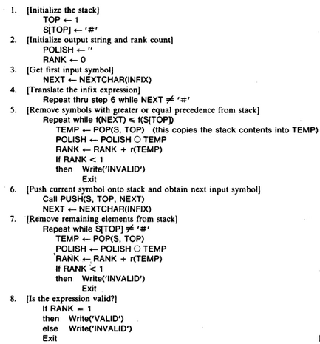
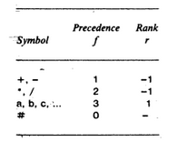
Conversion from infix to postfix (without parenthesis)

Slide 21
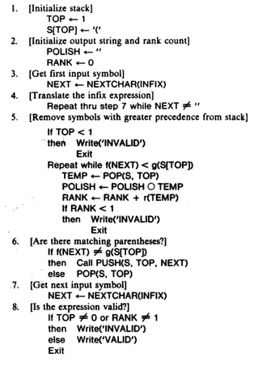
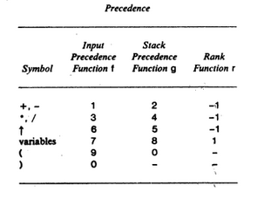
Conversion from infix to postfix (with parenthesis)

Slide 22
Conversion from infix to prefix (with parenthesis)
Step 1: Reverse the infix expression and convert ‘(‘ to ‘)’ and ‘)’ to ‘(‘.
Step 2: Read this reversed expression from left to right one character at a time.
Step 3: Rest of the steps remains same as in case of “conversion from infix to postfix (with parenthesis)”.
Step 4: After all the elements are popped, reverse the expression obtained in prefix expression.

Slide 23
Expression Evaluation
Evaluation of postfix expression
Evaluation of prefix expression
Evaluation of infix expression

Slide 24
Evaluation of postfix expression
Step 1: If char read from postfix expression is an operand, push operand to stack.
Step 2: If char read from postfix expression is an operator, pop the first 2 operand in stack and implement the expression using the following operations:
pop(opr1) then pop(opr2)
result = opr2 operator opr1
Step 3: Push the result of the evaluation to stack.
Step 4: Repeat steps 1 to steps 3 until end of postfix expression
Finally, At the end of the operation, only one value left in the stack. The value is the result of postfix evaluation.

Slide 25
Evaluation of postfix expression

Slide 26
Evaluation of prefix expression
Step 1: Reverse the prefix expression.
Step 2: Read this reversed prefix expression from left to right one character at a time.
Step 3: If char read from reversed prefix expression is an operand, push operand to stack.
Step 4: If char read from reversed prefix expression is an operator, pop the first 2 operand in stack and implement the expression using the following operations:
pop(opr1) then pop(opr2)
result = opr1 operator opr2
Step 5: Push the result of the evaluation to stack.
Step 6: Repeat steps 3 to steps 5 until end of reversed prefix expression
Finally, At the end of the operation, only one value left in the stack. The value is the result of prefix evaluation.

Slide 27
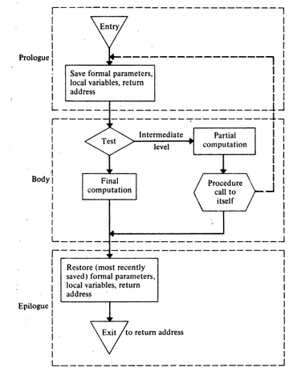
Recursion

Slide 28
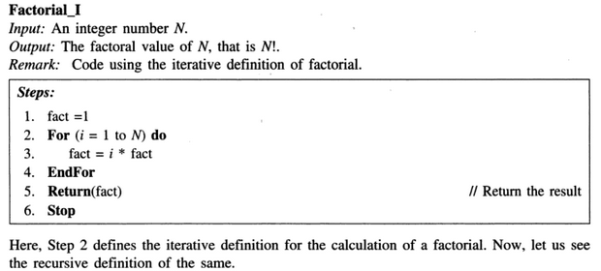
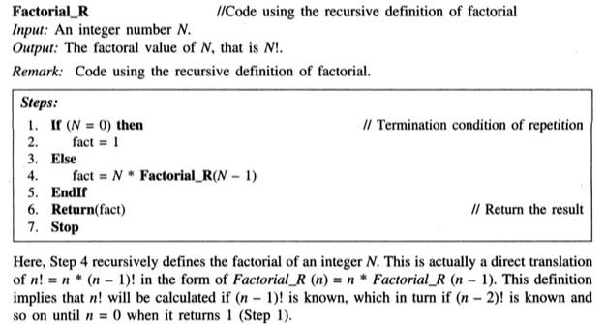
Recursion

Slide 29
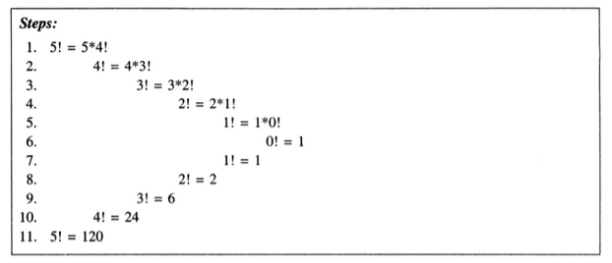
Recursion
Here, it is required to push the intermediate calculations till the terminal condition is reached. In the above calculation for 5!, Steps 1 to 6 are the push operations. The subsequent pop operations will evaluate the value of intermediate calculations till the stack is exhausted.
Stack for parameter(s): To store the parameter with which the recursion is defined.
Stack for local variable(s): To hold the local variable that are used within the definition.
Stack to store the return address.

Slide 30
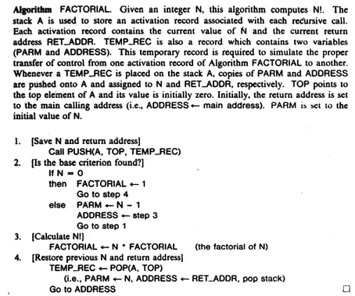
Factorial with recursion using stack

Slide 31
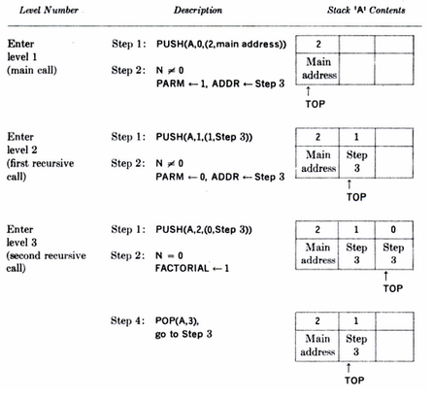
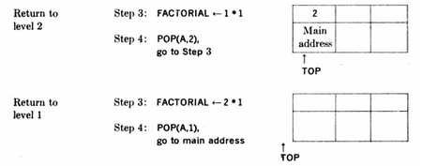

Slide 32
Tower of Hanoi Problem
The Tower of Hanoi puzzle is solved by moving all the disks to another tower by not violating the sequence of the arrangements.
The rules to be followed by the Tower of Hanoi are -
Only one disk can be moved among the towers at any given time.
Only the "top" disk can be removed.
No large disk can sit over a small disk.
Algorithm
Step 1 − Move n-1 disks from source to aux
Step 2 − Move nth disk from source to dest
Step 3 − Move n-1 disks from aux to dest

Slide 33
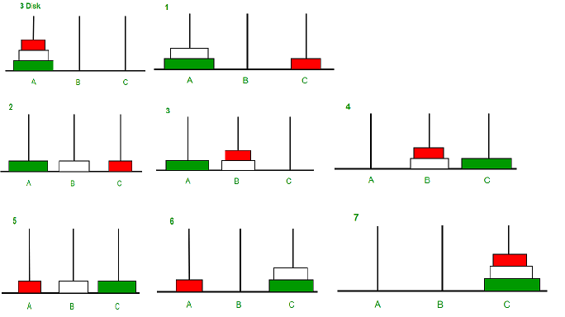
Example

Slide 34
THANK YOU!!
ANY QUESTIONS??

